Slide 1
The Gig Economy
Making It Work for Businesses and Workers Alike
October 6, 2022

Slide 2
Legal Issues
James LeNoury LeNoury Law
(416) 926-1107
jalenoury@lenourylaw.com

Slide 3
Agenda
Types of Employees
Jurisprudence addressing Gig Workers
What’s Next: Legislation
Questions

Slide 4
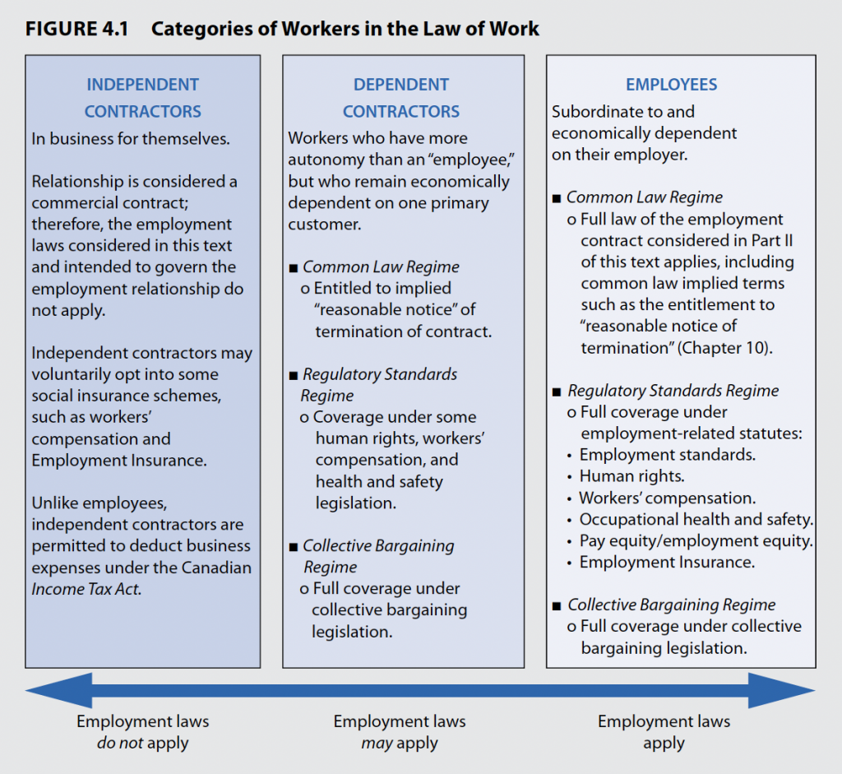
Professor David Doorey: “Why Gig Workers Are NOT Independent Contractors: A Primer”

Slide 5
“Independent contractor”, “Dependent contractor”, or “Employee”?
Employees:
Protected by the applicable employment standards legislation in their presiding jurisdiction
In Ontario, that legislation is the Ontario Employment Standards Act (the "ESA"). The ESA entitles employees to paid vacation, job-protected leaves of absence, and notice of termination, amongst other entitlements.
Independent contractors:
Not covered by the ESA. Not entitled to paid vacation, job-protected leaves of absence, or notice of termination.
Further, while employers are required to withhold and remit taxes and make CPP and EI contributions on behalf of employees, employers are not obliged to do so for independent contractors.
Independent contractors are responsible for paying their own taxes and making their own CPP and EI contributions.

Slide 6
“Independent contractor”, “Dependent contractor”, or “Employee”?
Dependent contractor:
May have more flexibility than a ‘true employee’, but are not entrepreneurs in the true sense:
they are not ‘running a business’;
they depend upon another entity to provide them the work;
don’t market their services or have a list of customers;
haven’t invested significant money in the business;
they don’t or can’t hire other people to do the work for them;
they have little or no control over the price at which their goods or services are sold;
Recognized by the Labour Relations Act but not recognized by the Employment Standards Act.

Slide 7
671122 Ontario LTD v. Sagaz Industries Canada Inc.
A case that outlines the distinction between independent contractors and employees.
“Although there is no universal test to determine whether a person is an employee or an independent contractor [...] The central question is whether the person who has been engaged to perform the services is performing them as a person in business on his own account.”
“Four Fold Test”
Control
Materials/Ownership of Tools
Chance of Profit
Risk of Loss

Slide 8
Jurisprudence addressing gig workers
CUPW v. Foodora Inc., 2020 CanLII 16750 (ON LRB)
UFCW Canada v. Uber Canada Inc., 2020 CanLII 54980, upheld on reconsideration in 2020 CanLii 93834
Sharma v. Uber, ESO Decision February 2022

Slide 9
CUPW v. Foodora Inc., 2020 CanLII 16750 (ON LRB)
Foodora challenged CUPW’s application for certification by arguing that the couriers were independent contractors and therefore, are not permitted to unionize in Ontario.
The Ontario Labour Relations Board determined that the Foodora couriers have little opportunity to act as true entrepreneurs such that they should be categorized as independent contractors.
The couriers are selected by Foodora and required to deliver food on the terms and conditions determined by Foodora in accordance with standards set by Foodora.
The Labour Relations Board found that the couriers work for Foodora, and not for themselves.
Dependent Contractors

Slide 10
CUPW v. Foodora Inc., 2020 CanLII 16750 (ON LRB)
The first decision with respect to workers in what has been described by the parties and the media as “the gig economy”.
Had the Labour Board determined that the Foodora couriers were independent contractors, they would not have had a legal right to unionize.
Two months following the decision, Foodora announced its closure in Canada. The company paid $3.46-million to its workers in settlement related to the closing.

Slide 11
UFCW Canada v. Uber Canada Inc., 2020 CanLII 54980 (upheld on reconsideration in 2020 CanLii 93834)
UFCW sought a representation vote for a bargaining unit of Uber Black Car Drivers (Uber Black are a specific Uber category – luxury vehicles/limousines)
Several preliminary applications were adjudicated before the Ontario Labour Relations Board, including a determination of the proper identity of the employer, and the appropriateness of the bargaining unit
Uber has repeatedly insisted that its drivers are independent contractors, and not employees. However, Uber and UFCW reached an agreement that the drivers would be permitted to unionize.

Slide 12
Sharma v. Uber February 2022: Employment Standards Officer Decision
Driver since 2020
ESA Complaint of improper deduction of pay
Employee status
Officer applied various tests:
Organization Test
Four Fold test
Ruled resembled an employee

Slide 13
Sharma v. Uber February 2022: Employment Standards Officer Decision
Violations
Failure to have a regular pay day (s.11.1)
Improper deduction of wages (s.13.1)
Failure to record daily hours worked (s.15.1)
Failure to provide time off from work and lunch periods (s. 18(6) and 20.(6)
Failure to pay minimum wage (Reg. 285/01 s.11)
Failure to pay holiday pay (s.26 and 28.1)
Uber was ordered to pay $919.37

Slide 14
What’s Next: Legislation
Digital Platform Workers’ Rights Act (Bill 88)
In April, 2022 the Ontario Government enacted, although not yet proclaimed into force, the Digital Platform Workers Rights Act, a first of its kind legislation in Canada.
The Act provides gig workers for online platforms, such as Uber, basic statutory entitlements such as a minimum wage, localized dispute resolution and information concerning their wages.
The new legislation protects gig workers from reprisals in the event that they pursue a wage claim or seek to enforce a prescribed right.
The minimum wage for those workers is only for “engaged time”: meaning companies are required to pay them for periods when they are driving customers or doing deliveries, but not for wait times in between.

Slide 15
Legislation (ctd)
Digital Platform Workers’ Rights Act
The Act provides some protections to gig workers, but still denies them the full suite of benefits that would be their due if they had formal employment.
Gig workers have long said that Bill 88 will not change their wages at all, because of the engaged time clause.
The Act did not change their employment status; the government still considers them independent contractors.

Slide 16
QUESTIONS

Slide 17
Legal Issues
James LeNoury LeNoury Law

